Slide 1








PowerShell Conference Asia
PowerShell Core 6 Community Platform for Hybrid Cloud

Slide 2



Hello!
Steve Lee Principal Software Engineer Manager
Joey Aiello Program Manager
PowerShell Conference
Singapore 2017

Slide 3
What will we cover?
The evolution of PowerShell
Windows PowerShell vs PowerShell Core
Going Open Source & Roadmap
Building a community
Remote management
Hybrid cloud management
Q&A
PowerShell Conference
Singapore 2017

Slide 4





1980s
1995
2006
2016

Slide 5
Windows PowerShell vs. Powershell Core
Windows only
Built into Windows and WMF (MSU)
Built on .NET Framework
$PSVersionTable.PSEdition is set to Desktop
Windows, macOS, and Linux
MSI, HomeBrew, RPM/DEB repos, portable ZIP
Built on .NET Core 2.0
$PSVersionTable.PSEdition is set to Core
PowerShell Conference
Singapore 2017

Slide 6
Pillars of PowerShell Core 6.0
Ubiquity: Windows, Nano, macOS, and Linux
Cloud: Built with cloud scenarios at the forefront
Community: Open Source and open collaboration
Compatibility: Built from Windows PowerShell leveraging .NET Standard 2.0
PowerShell Conference
Singapore 2017

Slide 7
6.0 is greater than 5.1, right?
PowerShell features are equal or better in PowerShell Core 6
Opportunity to consider breaking changes we would never have made in Windows PowerShell
Explicitly removed
Workflow
Custom Snap-Ins
WMI v1 cmdlets (Get-WmiObject, Invoke-WmiMethod, etc.)
RunspaceConfiguration
Not there yet
DSC resources (for now)
Cmdlet coverage
PowerShell Conference
Singapore 2017
Notes:
Platform
Consistent encoding
Consistency between Windows and non-Windows: filesystem, console host
Parameter binding bugs: input instead of args, ValueFromRemainingArguments
Pwsh.exe
Community feedback:
Export-CSV -NoTypeInformation
Unicode escape parsing
Web cmdlets improvements
Get-StringHash/Get-FileHash

Slide 8
.NET Standard 2.0
.NET Standard 2.0 brings almost* all .NET Framework 4.6.1 APIs to .NET Core 2.0
Use existing compatible Windows PowerShell modules in PSCore6
WindowsPSModulePath
Portable PowerShell Modules
PowerShell Standard 3.0
More reading on Youtube, on the .NET blog, or on GitHub
PowerShell Conference
Singapore 2017

Slide 9
Demo: Windows PowerShell Modules
PowerShell Conference
Singapore 2017
Notes:
Show:
Install-Module WindowsPSModulePath
Get-NetAdapter
Get-SMBShare
Get-NetConnectionProfile
Get-OptionalWindowsFeature –Online

Slide 10
What about Windows PowerShell 5.1?
Stable in-box platform for Windows automation
Supported but no planned new feature work
Security fixes and critical bug fixes in latest releases of Windows
Works great side-by-side with PowerShell Core 6
PowerShell Conference
Singapore 2017

Slide 11
Going Open Source
Get immediate feedback and contributions from the community
Learn from existing OSS projects: .NET Core, Chef, Puppet, etc…
Contributing guidelines
Streamlining development toolchain
RFC process: PowerShell Committee and Repository Maintainers
Monthly PSCore Community Call
PowerShell Conference
Singapore 2017

Slide 12
Getting to PSCore 6 Final
Beta.9 released this week!
Targeting a Release Candidate mid-Nov
Final release dependent on .NET Core 2.0.x servicing release (Dec/Jan)
PowerShell Conference
Singapore 2017

Slide 13
Life after PSCore 6 Final
PSCore6 final is a beginning, not an end
Targeting a 6 month release cadence
Preview releases continue on ~3 week cadence
Planning using GitHub Projects
Design using RFC process
Initially, investing in engineering improvements
PowerShell Conference
Singapore 2017

Slide 14
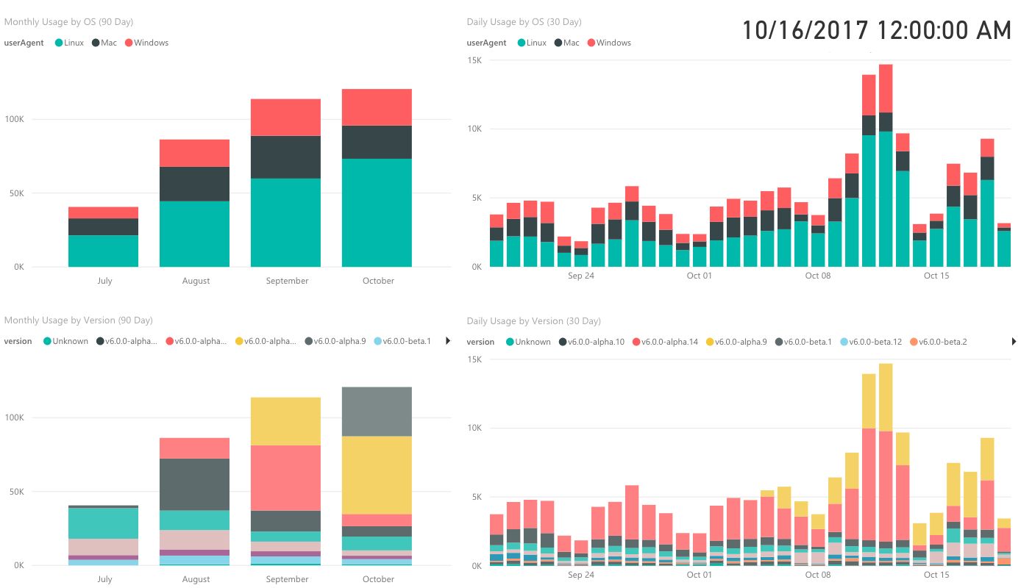
Thank You PowerShell Community!
PowerShell Conference
Singapore 2017

Slide 15
Demo: Community Contributions
PowerShell Conference
Singapore 2017
Notes:
# #4735 by @sarithsutha
# Start-Process -WhatIf
Start-Process notepad -WhatIf
# #2721 by @powercode
# Split-Path -LeafBase and -Extension
$PathToSplit = "$PSHome\powershell.exe"
Split-Path -LeafBase $PathToSplit
Split-Path -Extension $PathToSplit
# #3447 by @TheFlyingCorpse
# Invoke-WebRequest -NoProxy
Invoke-WebRequest -NoProxy 'https://github.com'
# #3443 by @iSazonov
# Tab completion of Select-Object -ExpandProperty
# Run in terminal
Get-ChildItem . | Select-Object -ExpandProperty <tab>
# #2787 by @kittholland
# Beautify JSON output
# Compare/contrast 5.1/6.0
Get-Module | ConvertTo-Json
# #3231 by @PetSerAl
# ConvertFrom-Json now unwraps arrays by default
# Compare/contrast 5.1/6.0
# This is a breaking change!
ConvertTo-Json ([PSObject](,1))
# #3142 by @Lee303
# Invoke-WebRequest support for custom HTTP methods
Invoke-WebRequest -Uri 'http://http.lee.io/method' -CustomMethod TEST
# #2850 by @powercode
# Add Parent process property to System.Diagnostics.Process
Get-Process | Where-Object Name -eq chrome | Format-List Parent
# #3958 by @rkeithhill
# Support for Unicode escape character
Write-Output "PowerShell`u{a9} loves community `u{1f44d}, open-source `u{1F44C}, and Linux`u{1F427}!"
# #4142 by @oising
# Type accelerator for System.Management.Automation.SemanticVersion
New-Object -TypeName semver
# #4184 by @ergo3114
# -Meta, -Charset, -Transitional support to ConvertTo-HTML
Get-Service | ConvertTo-HTML -Meta @{refresh=10;author="Author's Name";keywords="PowerShell, HTML, ConvertTo-HTML"} -Charset "UTF-8“
# #4844 by @joandrsn
# able to set credential using Set-Service
Set-Service myService –Credential $cred
# #4858 by @joandrsn
# Remove-Service cmdlet
Remove-Service myService
# #4842 by @LDSpits
# New-Module manifest defaults to 0.0.1 semver
# #4888 by @markekraus
# Add –ResponseHeadersVariable to Invoke-RestMethod
Invoke-RestMethod https://api.github.com/repos/powershell/powershell -ResponseHeadersVariable headers
# #5056 by @raghav710
# -NoNewline switch added to Out-String
“hello” | Out-String –NoNewline
# #4907 by @joandrsn
# Added BinPath, Description, UserName and Delayed Auto Start to Get-Service
# #5164 by @markekraus
# make –NoTypeInformation default for ConvertTo-CSV
Get-Prodess | select-object –first 5 | ConvertTo-CSV

Slide 16
How to Contribute
Use PowerShell Core!
Install instructions are in the README
File issues!
There’s an issue template, please use it
Give feedback on existing RFCs
Contribute code/docs/tests
Pull request lifecycle
You’re a newbie? Start with `Up-for-Grabs` issues
PowerShell Conference
Singapore 2017

Slide 17



What is Hybrid Cloud?
On-Premises
Workloads in various states
On-premises (non-cloud)
Windows Server
Linux
VMware
Azure
Other cloud providers
AWS
GCP
Hybrid vs. Heterogeneous
Azure
AWS, VMware, GCP
Windows
Windows/macOS/Linux
PowerShell Conference
Singapore 2017

Slide 18
Remote Management
Objects
Objects
PowerShell (Enter/New-PSSession)
PowerShell (Enter/New-PSSession)
Strings (text)
PowerShell Remoting Protocol (PSRP)
PowerShell Remoting Protocol (PSRP)
SSH client (ssh.exe)
WSMan/WinRM
OpenSSH

Slide 19
Demo: Remote Management
PowerShell Conference
Singapore 2017
Notes:
WSMan
SSH

Slide 20
Remote Management (continued)
Where to get OpenSSH for Windows?
Win32-OpenSSH releases and wiki
Optional feature in Fall Creators Update (1709)
Watch the PowerShell Blog for announcements
Limitations (for now)
WinRM Linux → Windows only supports Basic/NTLM auth
WinRM macOS → Windows only supports Basic auth
PSRP over SSH only supported on PowerShell 6.0+
PowerShell Conference
Singapore 2017

Slide 21
Q&A
PowerShell Conference
Singapore 2017

Slide 22
Thank You!
Steve Lee Principal Software Engineer Manager
@Steve_MSFT
Joey Aiello Program Manager
@joeyaiello
PowerShell Conference
Singapore 2017

Slide 23
Don’t Forget!
Fill in your survey in Mobile app – it’s how we do better!
Don’t lose you badge! You need it for the Social Events
Grab the Speakers for a chat – they all have time for you!
Let everyone know what they are missing on Social Media
#PowerShell
#PSConfAsia
Photos of Marina Bay Credit: Sebastian Szumigalski
PowerShell Conference
Singapore 2017

